Slide 1
Program Director
Training
Council Program Training

Slide 2
Agenda
Here are the topics we will cover today:
Overview – Program Director Basics
Faith In Action
Supreme Programs – Faith in Action Categories
Forms – 10784
Youth Protection Training – Requirements
Resources – Where to go for help when you need it
Council Program Training

Slide 3
Overview
The basics
Roles & Responsibilities – Program Director
Right programs – How to decide “what to do”
Basic steps – for a successful program
Volunteers – How to get volunteers?
Relationship – to Membership & Retention
Awards – Forms & Recognition
Council Program Training

Slide 4
Right Programs
How to choose?
Stop | Start (or keep)
Unsuccessful programs | Faith in Action Programs
Lack of volunteers | Interests your Council
Competition with Parish | Interests your Pastor
 | Attracts new members
Council Program Training

Slide 5
Basic steps
For a successful program
Program Leader
Permission of Pastor
Plan
Advertise
Execute
Recognize
Evaluate
Council Program Training

Slide 6
Volunteers
How to obtain
Interest – Pick programs that interest your council
Awareness – Make people aware of the program
Sign-up – At meetings, e-mails, internet, etc…
Bring a friend – Family, neighbor, others
Ask inactive – Ask 1 inactive member to every event
Train – What to do & how to do it
Enthusiasm – Show excitement and joy
Council Program Training

Slide 7
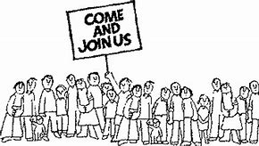
Membership
Ties to Programs
Fulfill a need – I want to do what you do!
Programs – Attract new members
Membership – Opportunities for programs
New Members (All members)
Know their program interests
Get them active, engaged & fulfilled
Council Program Training

Slide 8
Retention
Ties to Programs
Active | Inactive
Programs interest members | No/minimal interest in programs
Friendship | No/minimal friends
Feels valued | Feels not needed
Fulfilled | Empty
Self-motivated | Needs encouragement
Attends Meetings | Dislikes meetings
Knows “what to do” | Fear of the unknown
Council Program Training

Slide 9
Awards
Recognition
Recognition – People need to know they are appreciated
Individual & Team
Formal & Informal
Awards – Formal recognition
Council, State & Supreme
Council Program Training

Slide 10
Faith in Action
Replaces Surge… with service
Faith
Family
Community
Life
Council Program Training

Slide 11
Faith in Action
Categories & Council Roles
Faith Director – Church Based Programs Family Director / Chair Couple Life Director / Chair Couple Community Director
Council Program Training

Slide 12
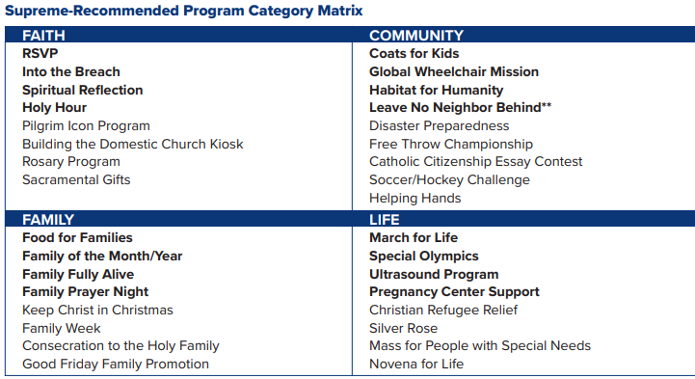
Council Program Training

Slide 13
Getting Started
How to…
Get educated
Meet with your Pastor
Plan your activities
Execute your activities
Council Program Training

Slide 14
Programs / Activities
Decide what to do
Do programs your Pastor wants to do
Weave in Supreme programs (where appropriate)
Council Program Training

Slide 15
Forms
Impact to Forms
Fraternal Program Report (#10784)
Need to fill one out for each Program
Columbian Award (#SP7)
Summary of Fraternal Program Report Forms
Focus on Faith, Family, Community and Life
Fraternal Survey of Activities (#1728)
Summary of Fraternal Program Report Forms
Focus on hours (and dollars) of service
MI 1 Form is Back!
Reported quarterly to the SDRR
Council Program Training

Slide 16
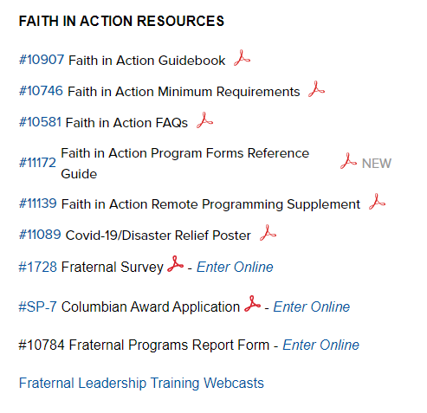
Fraternal Program Report Form (#10784)
Order your 10784 from kofc.org
You need your Membership Number and your last name
One for each Program
Submit forms Monthly
Save for reference
Needed for SP-7
Needed for 1728
Copy & edit for future programs
Council Program Training

Slide 17
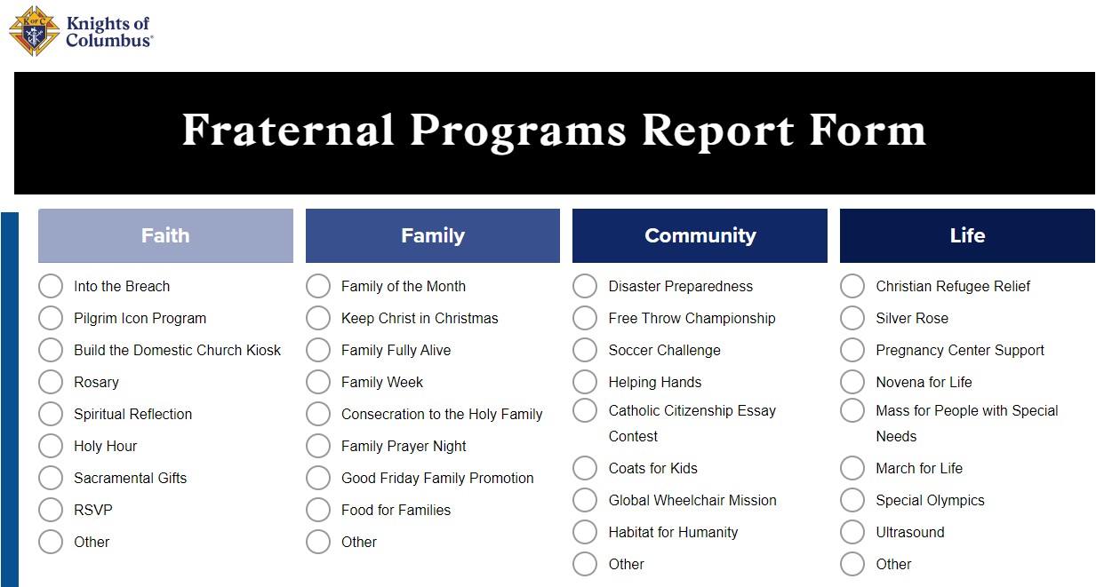
10784 Continued

Slide 18
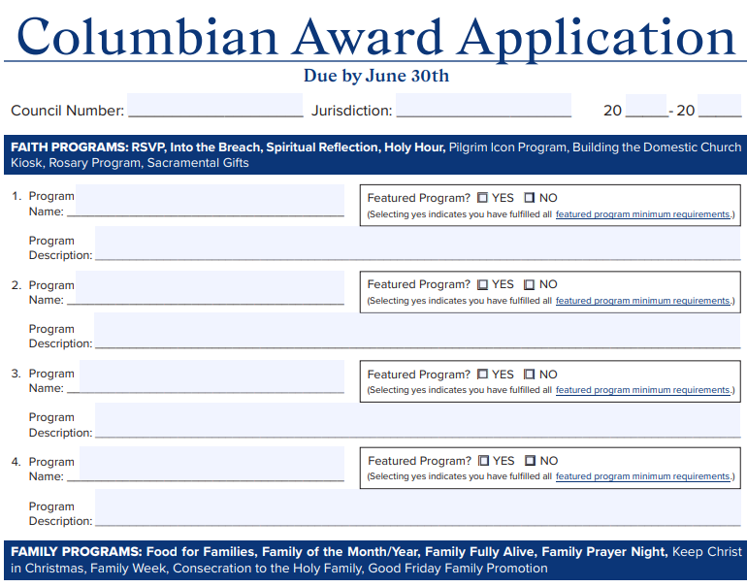
Columbian Award (#SP-7)
The new SP-7 merges and consolidates the information from 16 Fraternal Program Report Forms (#10784).
1 line for each form
Summary information only
Submit form annually (June)
Council Program Training

Slide 19
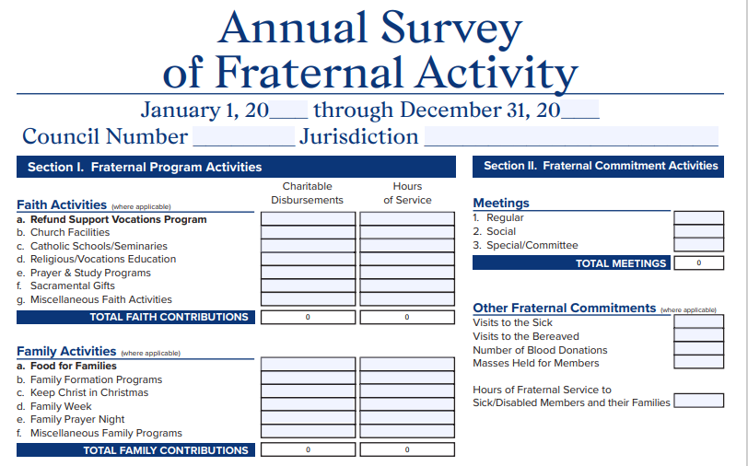
Fraternal Survey of Activities (#1728)
Left side of form:
Faith, Family, Community & Life
Consolidates information from forms #10784.
Right side of form:
Fraternal Commitment
Non-program activities
Council expense section
Submit form annually (January)
Council Program Training

Slide 20
MI 1 Form Returns
Quarterly report due to SDRR
If you qualify for Star Council you do not get MI 1 Award
Includes Officer Training requirement
More details to follow

Slide 21
Star Council and the Michigan Achievement Award

Slide 22
Star Council and the Michigan Achievement Award Continued…

Slide 23
Star Council and the Michigan Achievement Award Continued…

Slide 24
Youth Protection
Why is this important?
Who needs training & what do they need?
How to sign up for training
Armatus Site
Class 1 – Meet Sam
Class 2 – Duty to Report
Class 3 – KofC Safe Environment Policies
Background Check
Armatus Administration
Armatus Training: Step by step instructions

Slide 25
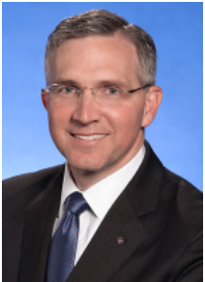
Why is this important?
There is no greater priority within the Order than the safety, security and protection of the children and young people who participate in its youth programs.
To help ensure the selection of only the best youth leaders for our programs, the Knights of Columbus has instituted the Safe Environment Program.
Armatus Training: Step by step instructions

Slide 26
Who needs Training?
Position | Meet Sam | Duty to Report Mandated Reporter | KofC Safe Environment Policies | Background Investigation
Grand Knight | Required | Required | Required
Program Director | Required | Required | Required
Community Director | Required | Required | Required | Required
Family Director | Required | Required | Required | Required
Armatus Training: Step by step instructions

Slide 27
How to sign-up for training
Council submits Service Program Personnel (Form 365)
Supreme notifies Praesidium
Praesidium sends e-mail to members for training
Armatus Training: Step by step instructions

Slide 28
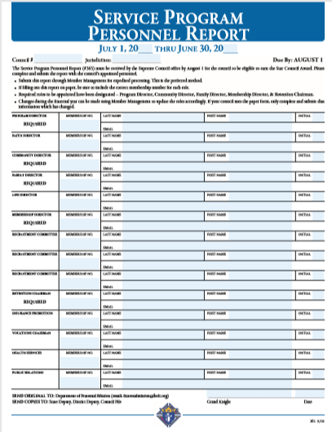
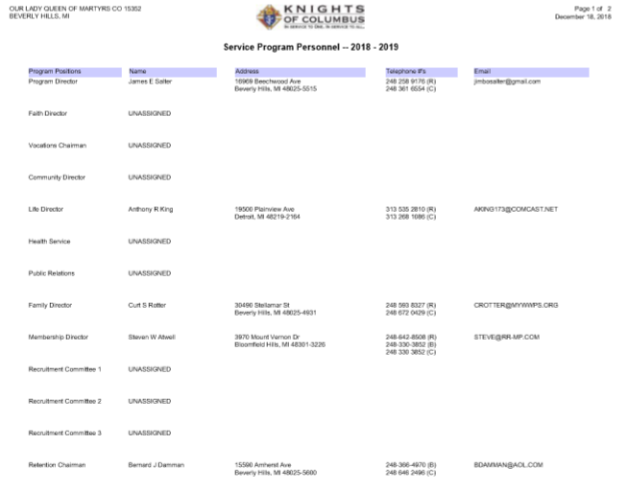
Council Submits Service Program Personnel Report
Option 1: Submit form 365 = Service Program Personnel Report
Option 2: Filling Service Program Personnel via Member Management
Option 2 is preferred for the following reasons:
Supreme is notified immediately (nothing needs to be sent to Supreme)
Minimizes chance of human error (misplace forms, etc…)
Key things to keep in mind:
Ensure forms contain accurate and updated e-mail addresses for the members. (Otherwise, they will not receive the notice to take the training)
This form is due August 1st
Armatus Training: Step by step instructions

Slide 29
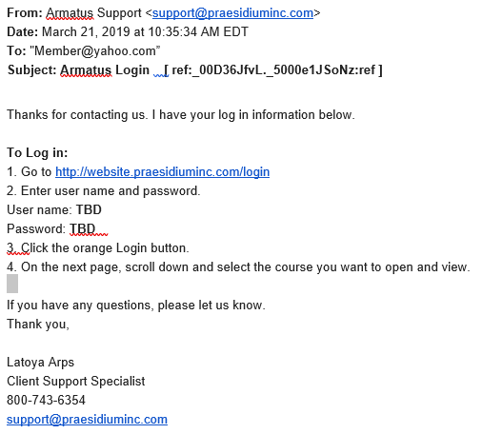
Praesidium sends e-mail to members for training
Click on this link to access the ARMATUS training website.
Use your User Name provided here
Use the temporary password provided here
Armatus Training: Step by step instructions

Slide 30
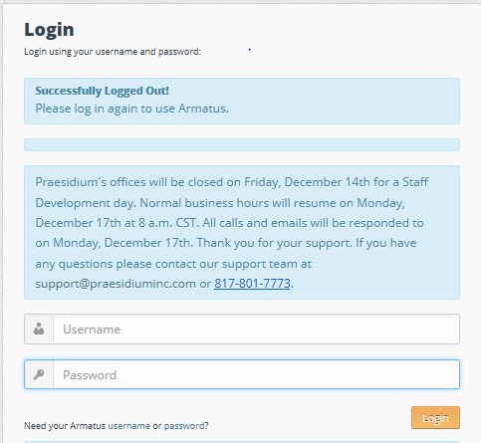
E-mail & Login process
Armatus Training: Step by step instructions

Slide 31
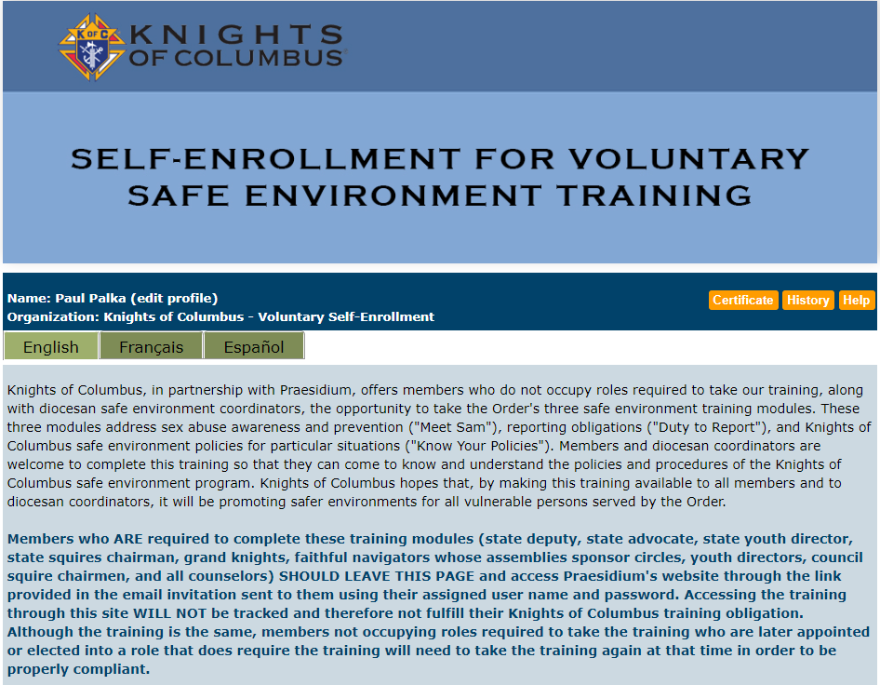
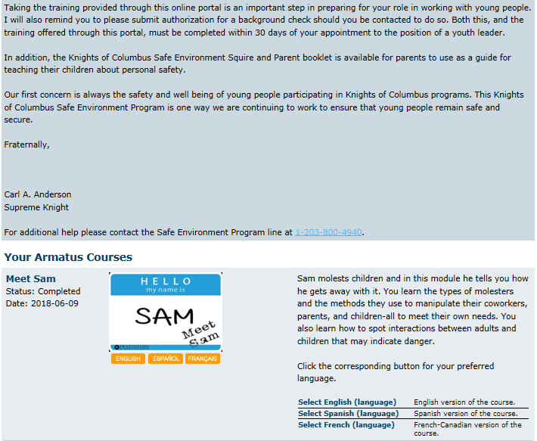
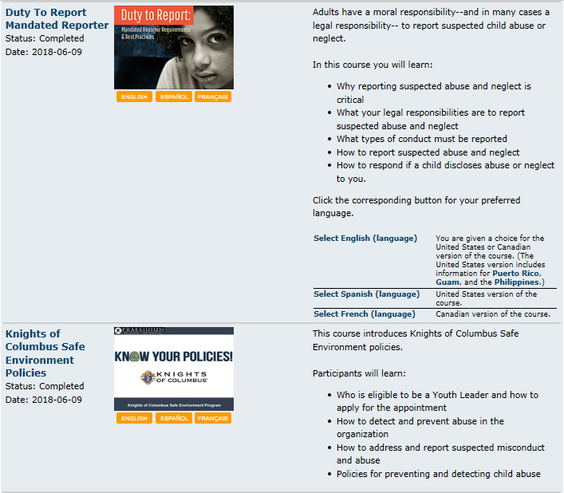
Armatus Site
Please read as this explains why this is so important.
Meet Sam – This is the first (of 3) classes. Click on Meet Sam to take this class.
Duty To Report – This is the second (of 3) classes. Click on Duty To Report to take this class.
KofC Save Environment Policy – This is the third (of 3) classes. Click on KofC Save Environment Policy to take this class.
Background Check (not shown here) must also be selected by all Community Directors & Family Directors.
Armatus Administration is a very useful tool for Grand Knights to use to monitor the training progress of council members.
Armatus Training: Step by step instructions

Slide 32
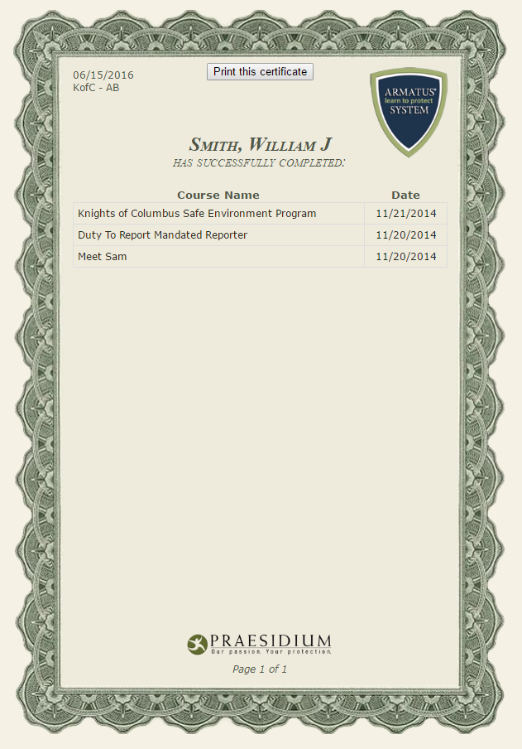
Training Certificate
Print or save your course completion certificate
Your Name Here
Armatus Training: Step by step instructions

Slide 33
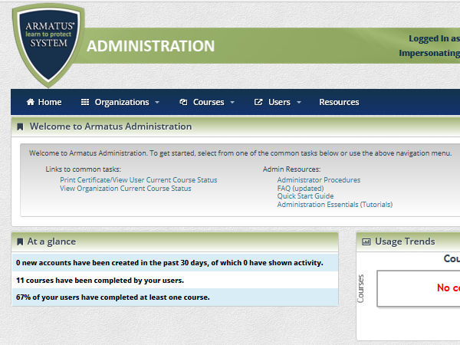
Armatus Administration
Click on this link to see the current course status of everyone who is registered for training in your council.
Note: If you left a position blank on your Service Program Personnel report, the person will NOT show up on this report. So, even if this report says all classes are complete, your council may not be complete.
Armatus Training: Step by step instructions

Slide 34
Resources
You don’t have to “know” everything. You just need to “know” where to find the answers
Faith In Action Manual (#10590)
Leadership Guide (Found at MIKOFC.org)
Supreme website (www.kofc.org)
State website (www.mikofc.org)
Council Officers and Past Grand Knights
District Deputy
State personnel
Council Program Training

Slide 35
Summary
Module | Description | What you should know
1 | Overview | R&Rs & importance
2 | Faith in Action | Faith, Family, Community, Life
3 | Supreme Programs | Lists programs in all categories Getting started
4 | Forms | Fraternal Program Report Form Columbian Award Form Annual Survey of Fraternal Activity
5 | Youth Protection | Requirements & process
6 | Resources | Material at your disposal Grand Knight & Past GKs District Deputy State / Supreme
Council Program Training
Notes:
What to Say:
We covered what we said we’d cover
God bless you for doing this important job for your council.
The future of your council is “to a large extent” on your shoulders.

Slide 36
Program Director
Council Program Training

